Slide 1
IBM Data science capstone
Using foursquare to test out business names

Slide 2
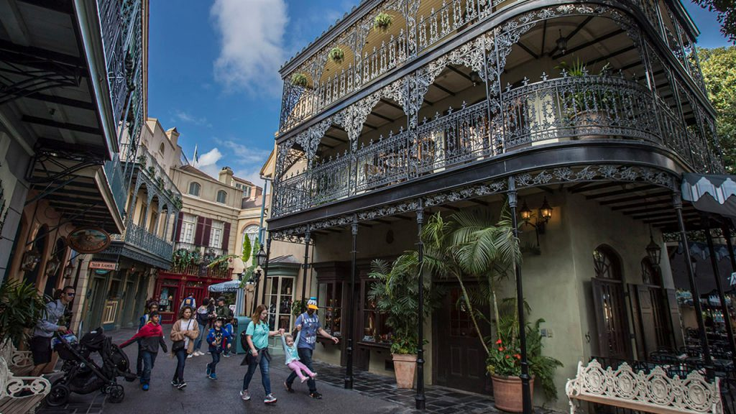
Intro to business problem
An entrepreneur would like to start a business in New Orleans and would like to know the prevalence of the word ‘Cajun’ in business names versus ‘Acadian’.

Slide 3
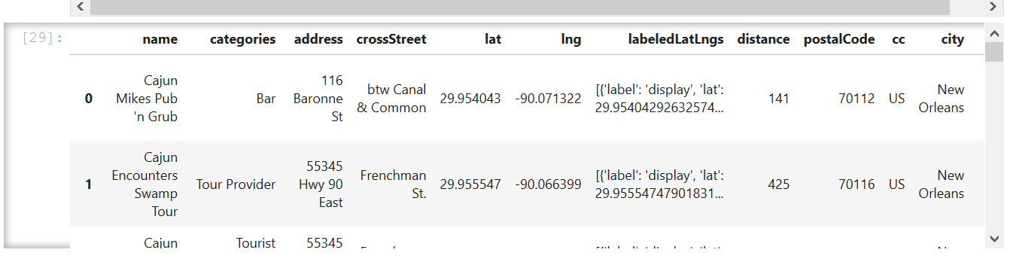
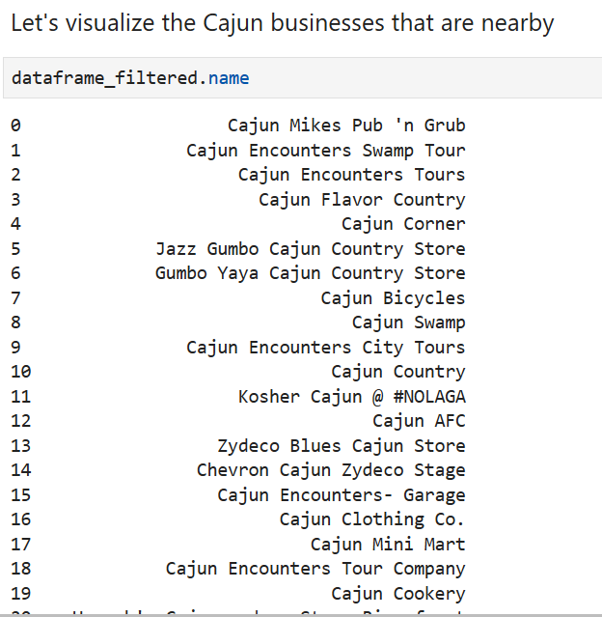
Data: Venue names and categories

Slide 4
Methodology
Import pandas, numpy, requests, folium
Define Foursquare credentials and version
Set address
Search for first search term ‘Cajun’ and GET results
Get relevant part of JSON and transform it into pandas dataframe
Define information of interest
Visualize businesses within 1km of target address
Repeat steps 4-7 with search term ‘Acadian’
Compare results

Slide 5
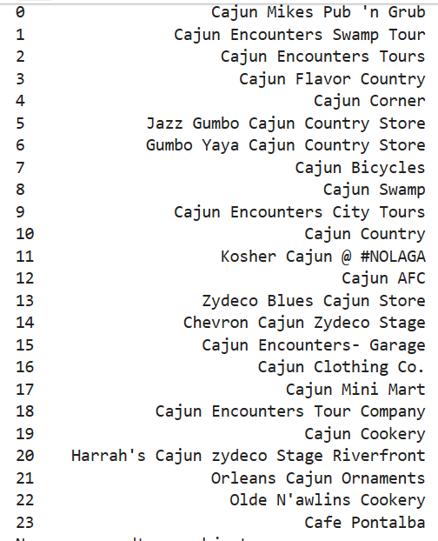
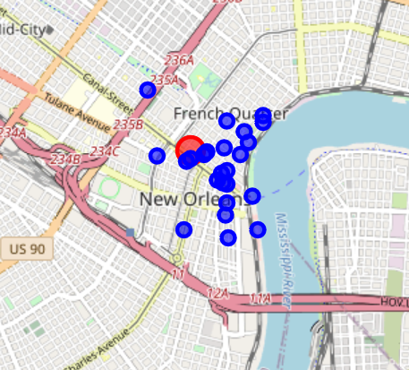
Results : Cajun

Slide 6
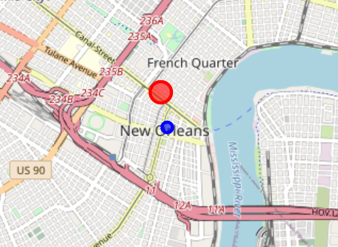
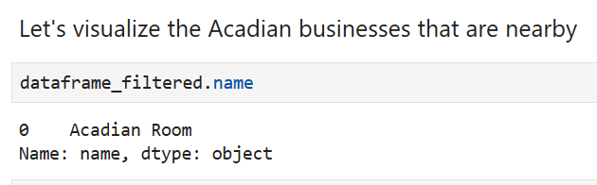
Results : Acadian

Slide 7
Discussion
There are 23 businesses with a name or category with Cajun within 1 km of the target address.
There is 1 business with a name or category with Acadian within 1 km of the target address.

Slide 8

Conclusion
Acadian is a more unique name.
Recommendation is to use Acadian in the business name.

